Slide 1
Charting the Dalitz – An exploration of phase-space selection efficiencies within LHCb
By Divij Gupta
Supervisors : Professor Chris Parkes and Dr. David Friday
University of Manchester - MPhys project, Semester 2

Slide 2
Brief overview of Theory and Motivation

Slide 3
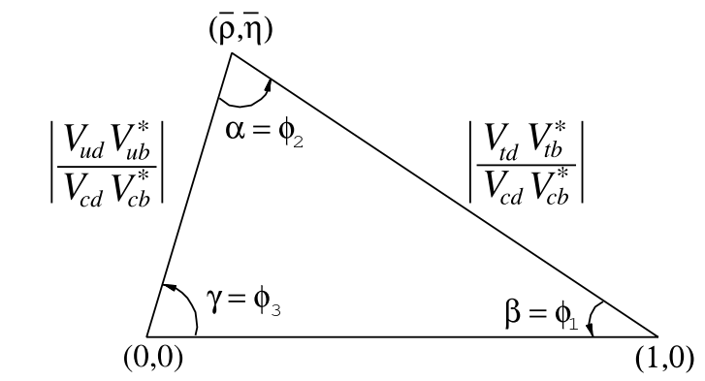
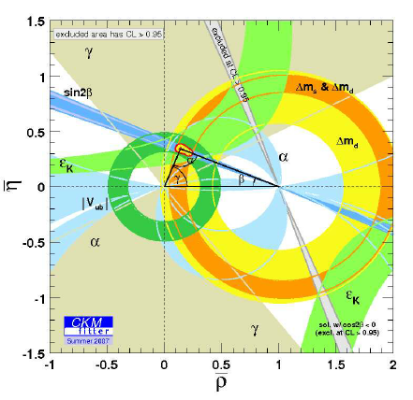

CP Violation and Charm Physics
Matter favoured in Big Bang – CP (Charge-Parity) violation
Inclusion into SM (Standard Model) in quark flavour mixing through CKM matrix – several orders of magnitude off
A test for $V_{CKM}$ - Unitarity Triangle
3 types of CP violation – weak decays, mixing, interference between both
First observed in weak decay of K-mesons and B-mesons, in agreement with SM
Small CP violation present in Charm decays – statistically significant evidence at LHCb in 2019

Slide 4
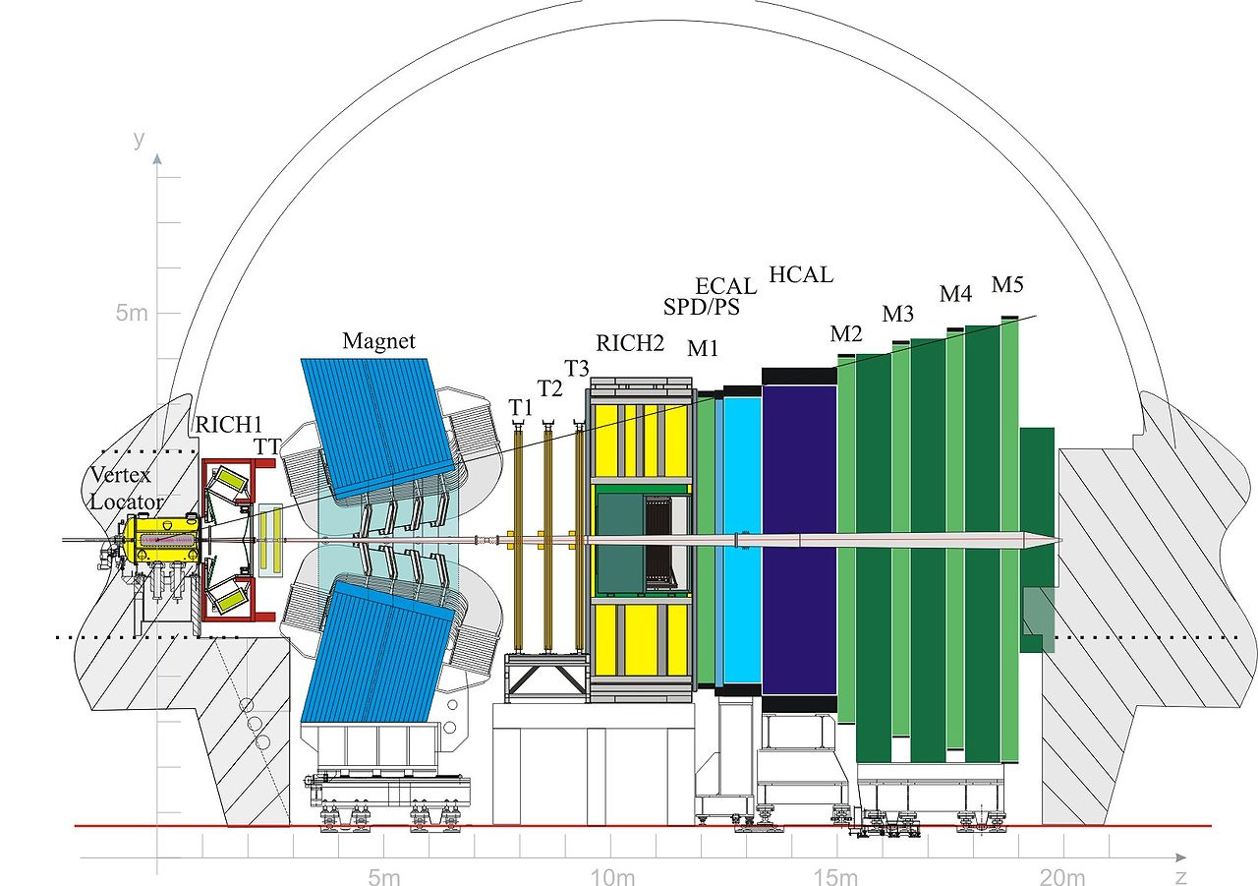
LHCb Detector Overview
Vertex Locator (VELO) around pp-collision point – charged particle tracking
Vertical dipole magnet ~4 Tm and Silicon strips (T1-3) – charged particle track and momentum
Cherenkov Rings (RICH) – charged particle velocity
Momentum and velocity give the type of charged hadron
Calorimeters (ECAL, HCAL) with layers of iron and scintillator – sensitive to neutral particles
RICH more precise than Calorimeters
Too much data - offline triggers and online reconstruction algorithms
Missing events that pass detection – characterise the efficiency of the detector

Slide 5
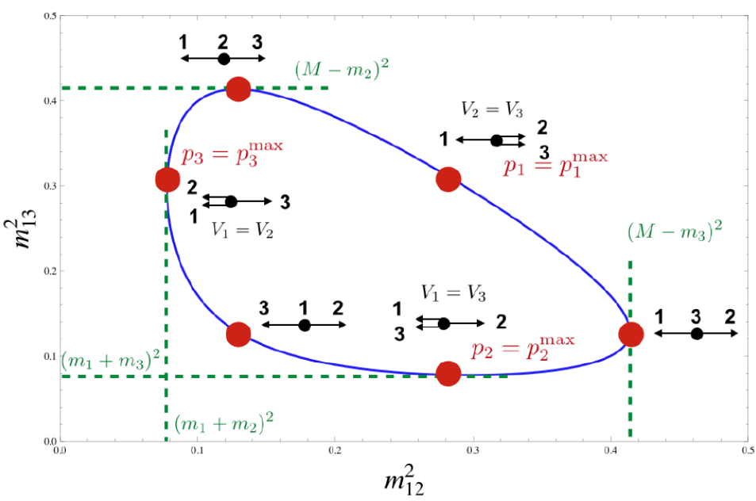

Dalitz plots
Describe full phase space and kinematics of a pseudo-scalar decay
For 3-body decay - 2 independent quantities, $m_{13}^{2}$and $m_{12}^{2}$ invariant masses
Useful for highlighting intermediate resonances and angular phases - Dalitz plot density$∝$ total decay amplitude
Use to characterise detector efficiencies in different parts of phase space
Low momentum – bent out of the magnet and large EM shower in HCAL
High momentum – clean tracks and little scattering (but possibly little bending)
Neutral particles inherently hard to detect
Centre of mass frame
Notes:
RICH very important in distinguishing between mesons (pions and kaons)

Slide 6
Results, Analysis and Discussion

Slide 7

Brief Overview
First look and Efficiency
Binned plots
Polynomial fitting
Pulls and reduced $χ^{2}$
Pulls and reduced 𝜒^2
Stability of Dalitz space
Removing edge bins
Calculating efficiency and errors
Kernel Density Estimation
Overview & unbinned plots
Square Dalitz plots
Motivation
2D 3rd order Chebyshev polynomial
Folding along the diagonal
Optimising for the bandwidth
Re-optimsing for the bandwidth
Reflecting boundary conditions
Invariant mass projection
Used one decay mode for testing : $D^{0}→K_{s}^{0}π^{+}π^{−}$
$K_{s}^{0}$ is short lived and decays into charged $π^{+}π^{−}$ - easier to reconstruct charged tracks, hard to determine if it was from $K_{s}^{0}$ decay
Data used : Flat Space - ROOT’s TGenPhaseSpace jjjjjjjjjjjjjjjjjjjjjjjjjjjjjMonte Carlo (MC) - LHCb detector simulation
Brief outline of the steps taken:
Binned techniques
Un-binned techniques

Slide 8
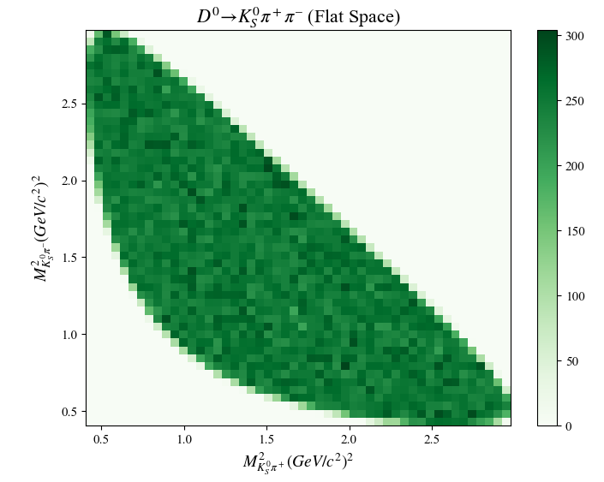
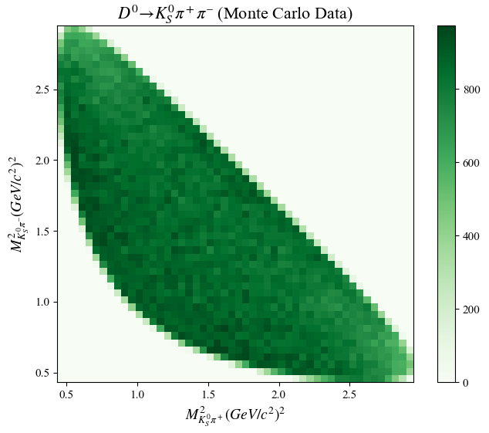

First look and Efficiency Calculation
Binned Dalitz plots for Flat space and MC data – no resonance structure
Efficiency and errors : $ε_{i}=A \frac{N_{i}^{obs}}{N_{i}^{true}}$ and $σ_{ε_{i}}=\sqrt{\frac{ε_{i}(1−ε_{i})}{N_{i}^{true}}}$
Error formula breaks down when $N_{i}^{obs}=0 or N_{i}^{true}$ but this isn’t important for here (also, there are ways to mitigate using Bayes’ Theorem)

Slide 9
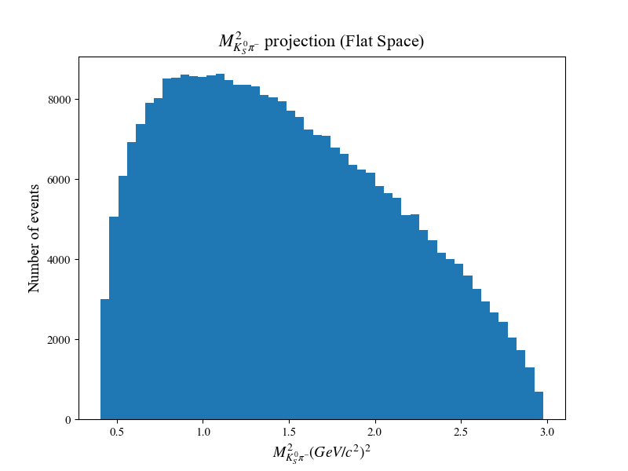
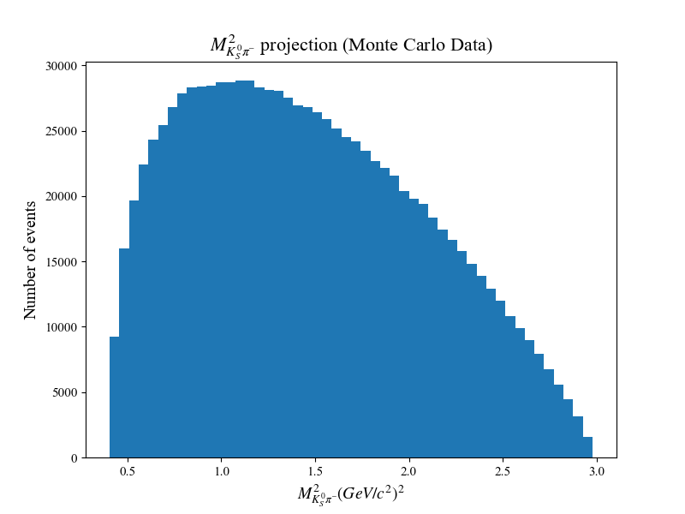

Slide 10
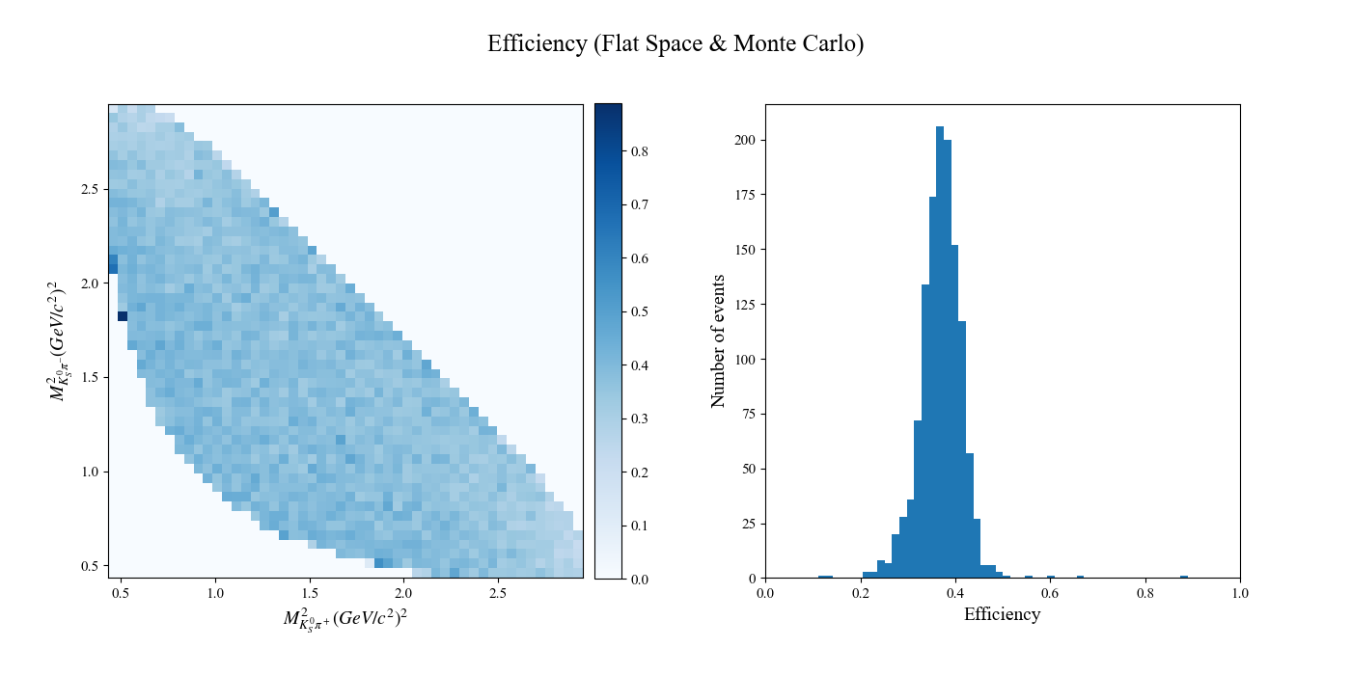

Slide 11
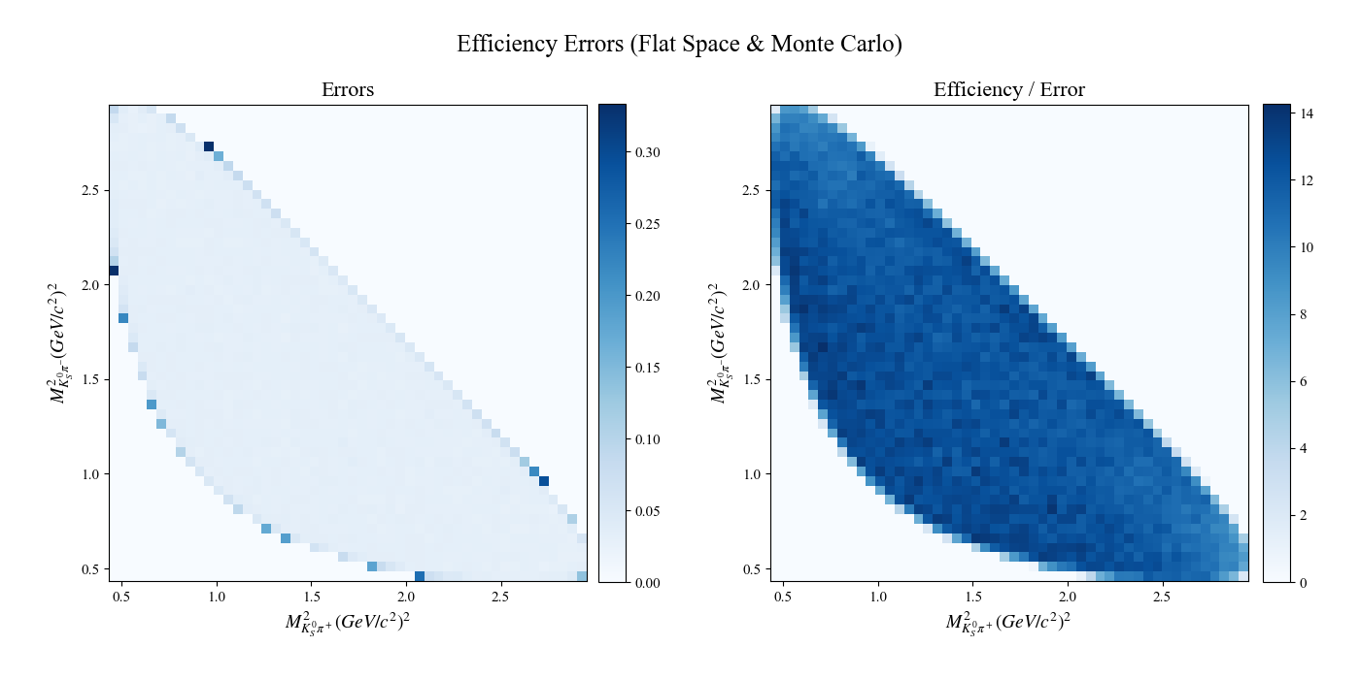

Slide 12

Polynomial fitting
Required to smoothly model efficiency at any point in phase space
Polynomial least squares fit using analytic least squares solution
Best (lowest order) fit to 2D cubic Chebyshev polynomial – remove fitting difficulties from correlated fit parameters
Pulls to determine quality of fit : $pull_{i}= \frac{ε_{i}−ε_{i}^{pred}}{σ(ε_{i})}$
The histogram of the pulls should be standard normal and $χ_{red}^{2}$ close to 1
Slight discrepancy due to unknown true sample size of MC data – normalisation cannot be fully trusted

Slide 13
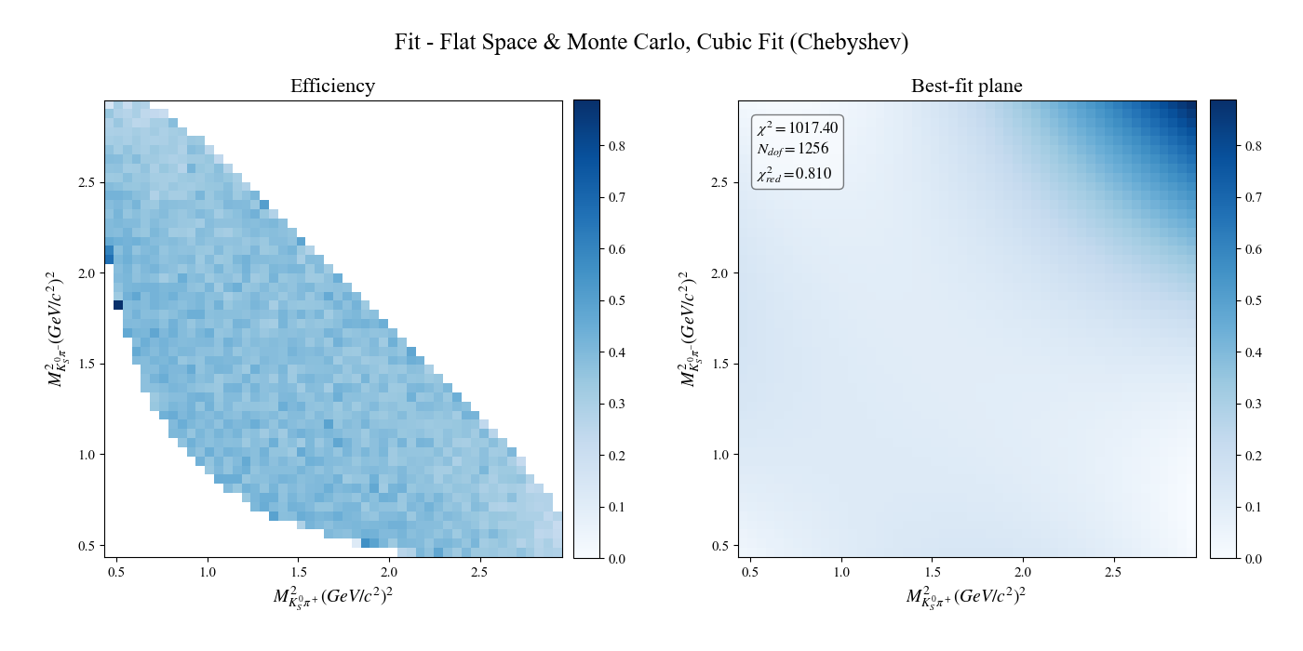

Slide 14
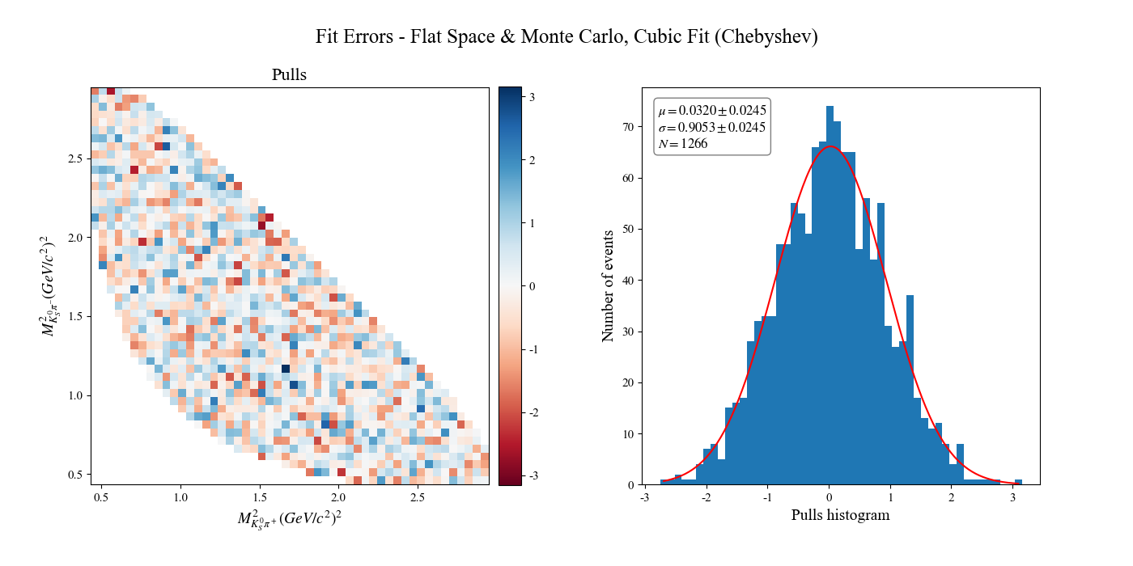

Slide 15
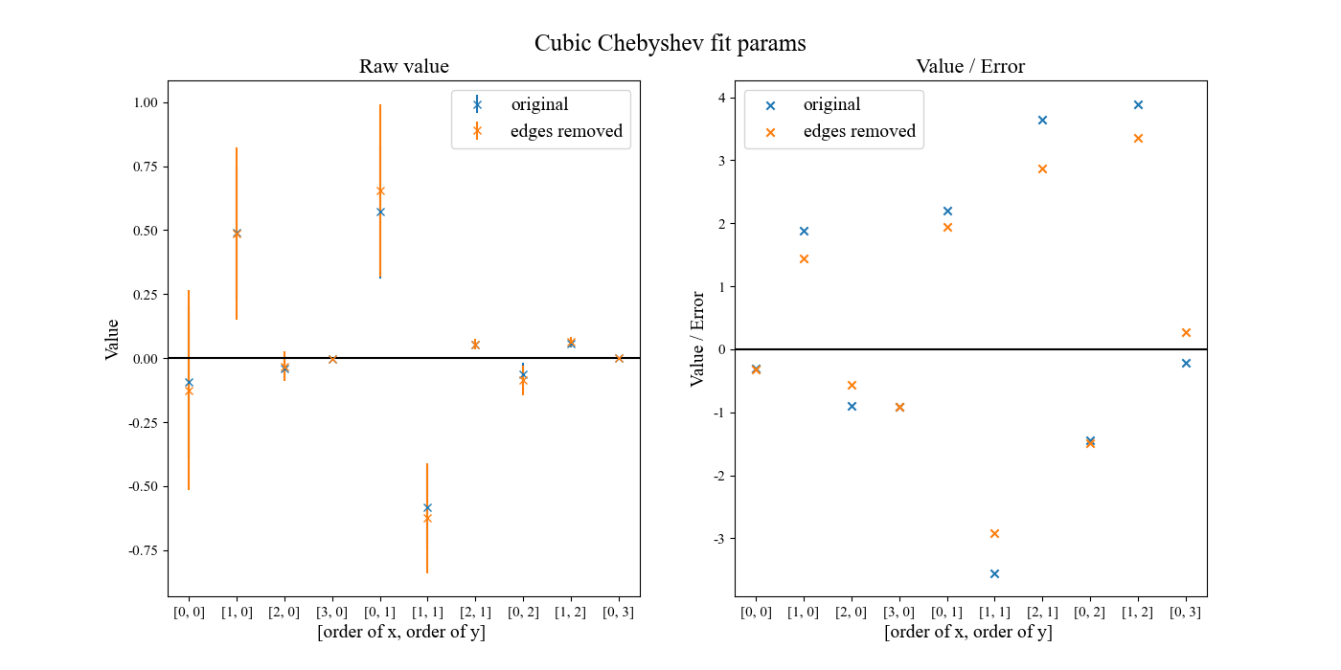
Testing Stability – Removing edge bins
Outer edges sparsely populated – large errors potentially bias the fit
Remove the outer edges and re-do fitting scheme & look at fit parameters
No real observed difference

Slide 16
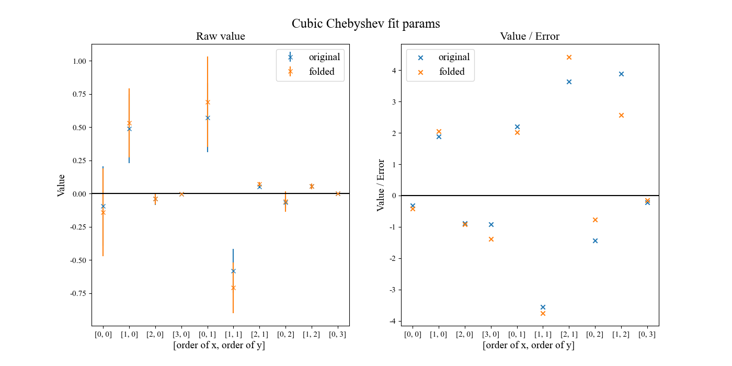
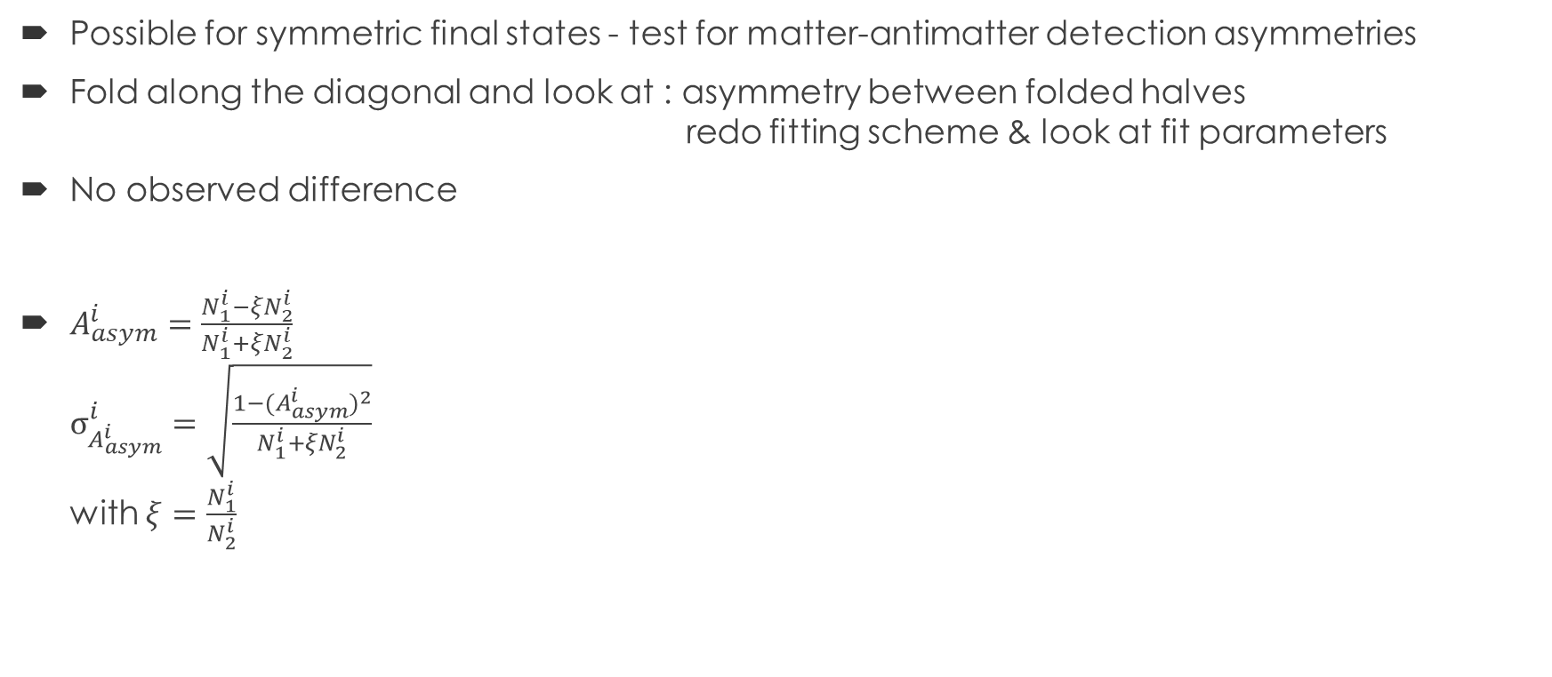
Testing Stability – Folding along diagonal
Possible for symmetric final states - test for matter-antimatter detection asymmetries
Fold along the diagonal and look at : asymmetry between folded halves gggggggggggggggggggggggggggjredo fitting scheme & look at fit parameters
No observed difference
$A_{asym}^{i}=\frac{N_{1}^{i}−ξN_{2}^{i}}{N_{1}^{i}+ξN_{2}^{i}}$ $σ_{A_{asym}^{i}}^{i}=\sqrt{\frac{1−{{(A}_{asym}^{i})}^{2}}{N_{1}^{i}+{ξN}_{2}^{i}}}$ with $ξ=\frac{N_{1}^{i}}{N_{2}^{i}}$

Slide 17
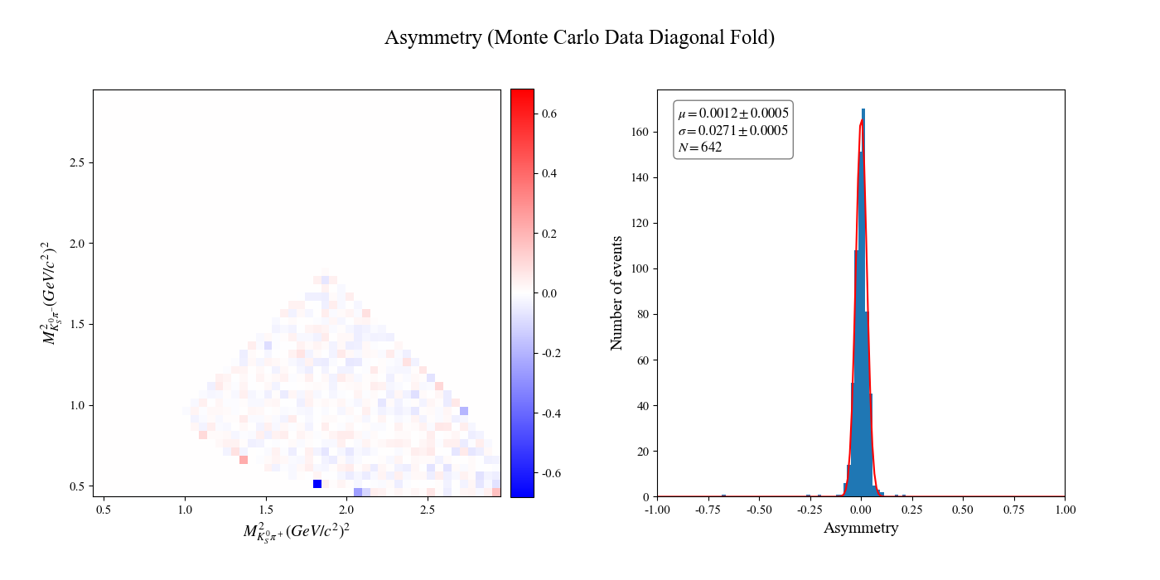
Notes:
RICH very important in distinguishing between mesons (pions and kaons)

Slide 18
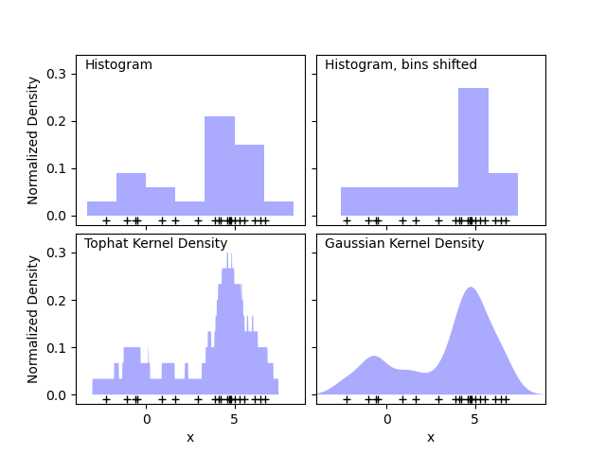
Kernel Density Estimation (KDE) - Introduction
Machine learning algorithm to perform un-binned fits – model independent
Works by stacking ‘blocks’ directly on desired points and adding up all the contributions (convolution)
Choice of ‘kernel’ (block shape) and bandwidth / smoothing parameter (block size)
Usually use Gaussian Kernels – representative of underlying statistical nature
Bandwidth (h) estimated by Scott and Silverman methods (could use some work)
Figures from scikit-learn (F. Pedregosa, G. Varoquaux, et al., “Scikit-learn: Machine learning in Python,” Journal of Machine Learning Research, vol. 12, pp. 2825–2830, 2011)
Notes:
RICH very important in distinguishing between mesons (pions and kaons)

Slide 19
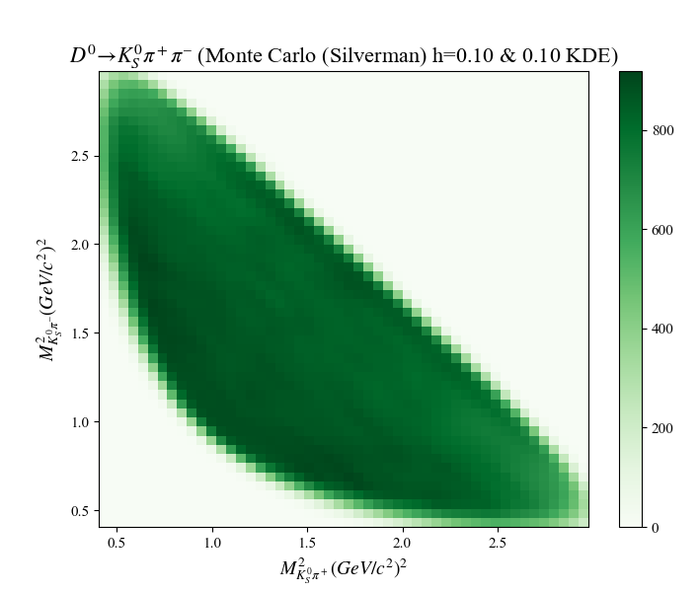

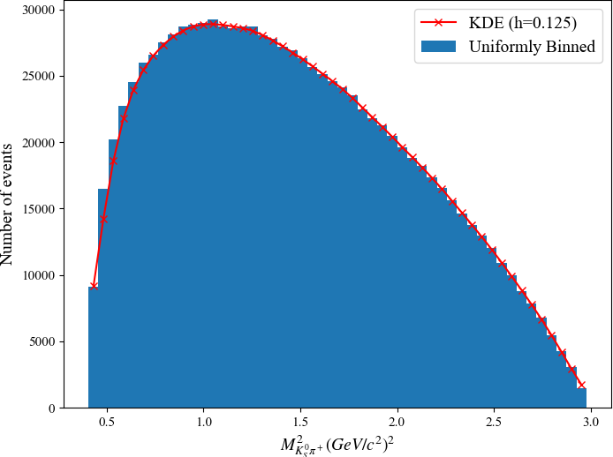
Notes:
RICH very important in distinguishing between mesons (pions and kaons)

Slide 20
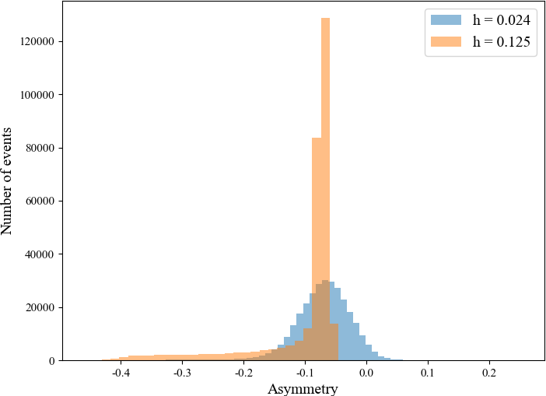

KDE – Optimising for the bandwidth
Test fit quality and optimise for bandwidth manually – need test sample with known ‘truth’ to compare results
Using Monte Carlo sampling on flat space, generated cubic rejected sample – used fit parameters from polynomial fitting to mimic MC structure
Vary the bandwidth and perform $χ^{2}$ comparison to find minima
Absolute scale cannot be interpreted – lack of knowledge of nature of the fits and KDE errors
Investigate asymmetry between KDE output and truth
Some non-zero offset and odd tail observed for Silverman’s method

Slide 21
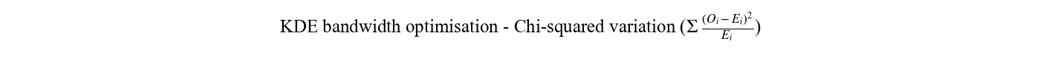
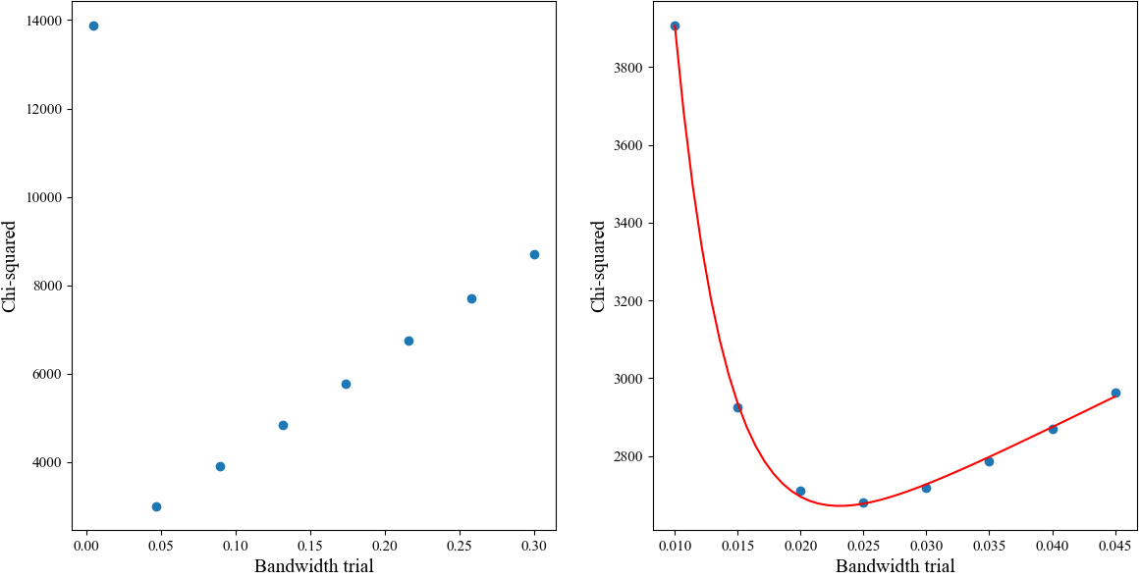
Minima: h = 0.024
Notes:
RICH very important in distinguishing between mesons (pions and kaons)

Slide 22

Square Dalitz Plot
Problem with KDE is that the distribution must smoothly go to zero which is unphysical in this case – KDE is potentially too sensitive to this
Hard to impose boundary conditions in normal Dalitz space – Square Dalitz Space
Variables : $m^{′}=\frac{1}{π}\left(2\frac{m_{12}−m_{12}^{min}}{m_{12}^{max}−m_{12}^{min}}−1\right)$ and $θ^{′}=\frac{1}{π}θ_{12}$ with $\cos\left(θ_{12}\right)=−\frac{m_{12}^{2}−m_{1}^{2}−m_{3}^{2}−2E_{1}E_{3}}{2|p_{1}||p_{3}|}$
Re-optimise for bandwidth in the same way – correcting for Jacobian structure
Done with and without reflections with same asymmetry comparison

Slide 23
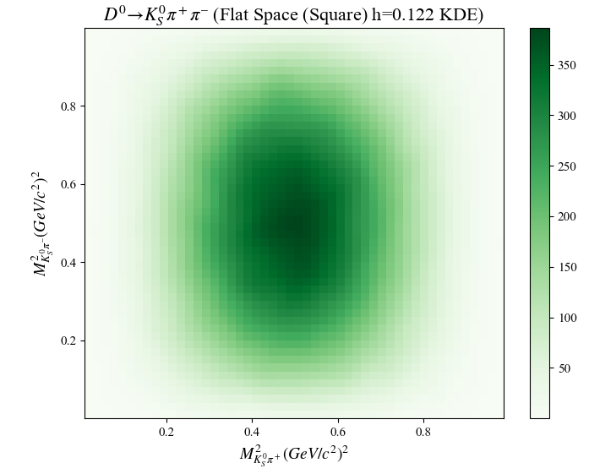
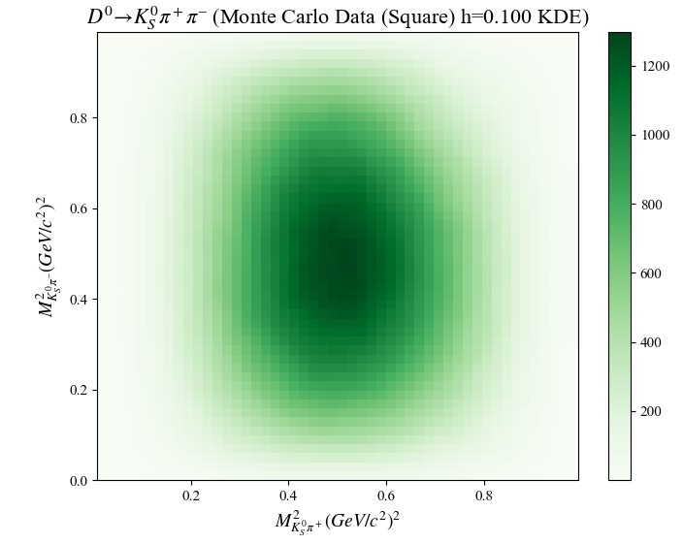
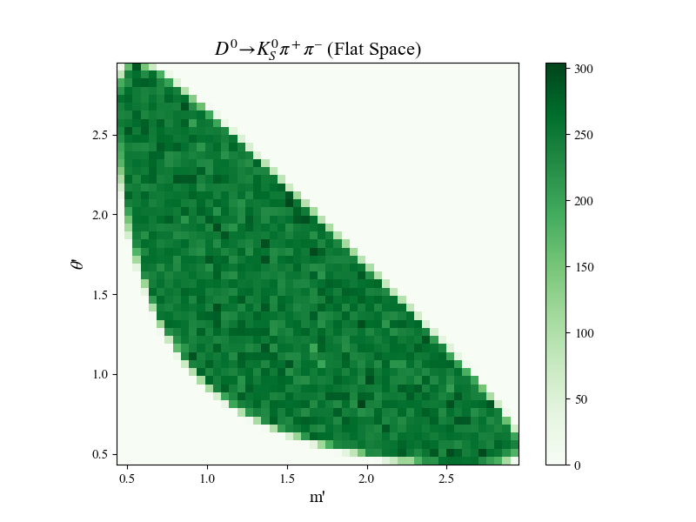


Slide 24
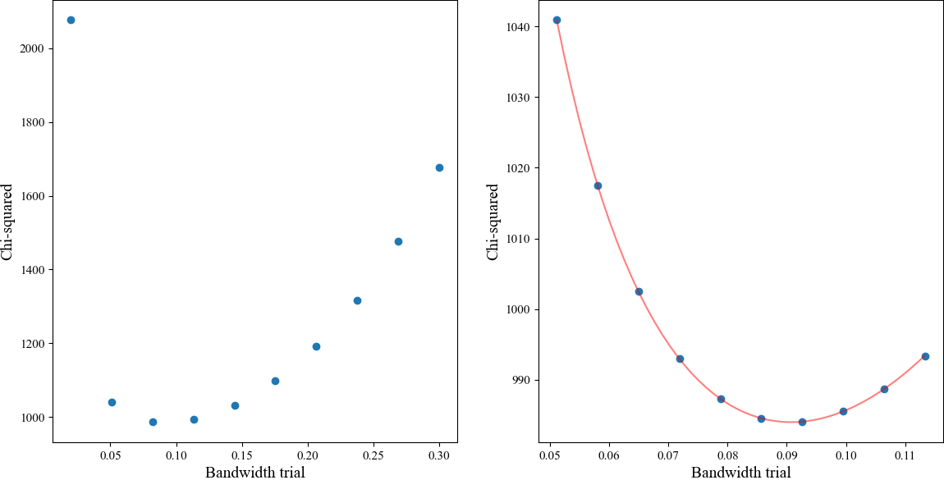
Without Reflections
Minima: h = 0.091
Minima: h=0.024
Notes:
RICH very important in distinguishing between mesons (pions and kaons)

Slide 25
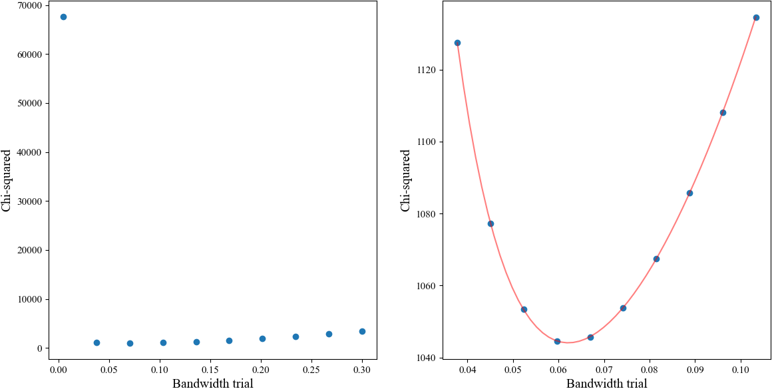
With Reflections
Minima: h = 0.062
Notes:
RICH very important in distinguishing between mesons (pions and kaons)

Slide 26
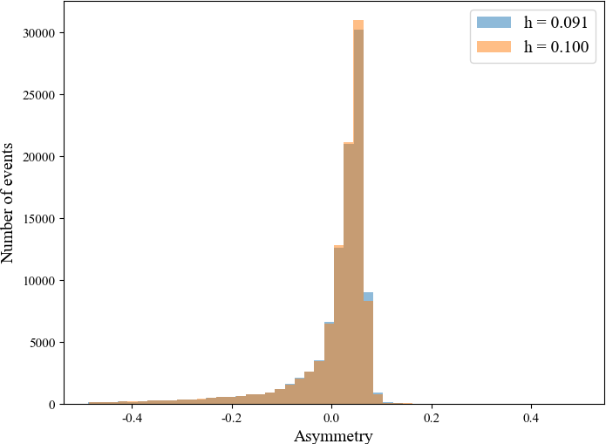
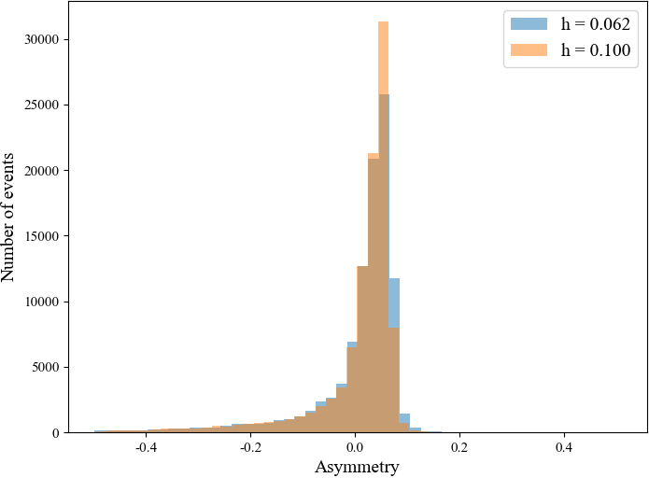
Without Reflections
With Reflections
Notes:
RICH very important in distinguishing between mesons (pions and kaons)

Slide 27

KDE – Discussion of all results
Seem to be a step in the right direction - $χ^{2}$ variation parabolic about minima
Asymmetry still has an offset and tail behaviour isn’t removed – not properly understood, possibly a systematic error
Overall results :
Further testing needed before KDE bandwidth optimisation can be used – explore which areas of phase space the tails live in
At the very least for normal Dalitz space – Silverman’s method can’t be trusted
 | Manual Optimisation | Silverman/Scott
Standard | 0.024 | 0.125
Square Dalitz | 0.091 | 0.100
Square Dalitz & Reflections | 0.062 | 0.100

Slide 28
Conclusion and Future Work
Binned polynomial fit: 2D cubic Chebyshev polynomial best
Removing edge bins or folding the space doesn’t affect results
Un-binned KDE fit: Looks promising but needs work in Square Dalitz
Normal Dalitz space shows Silverman’s estimate is untrustworthy
Overall: Best to use polynomial fits until KDE bandwidth is better characterised
Other future work into extending use case to higher orders – add time dependence sensitivity

Slide 29
Thank you and let me know if you have any questions!

